Slide 1
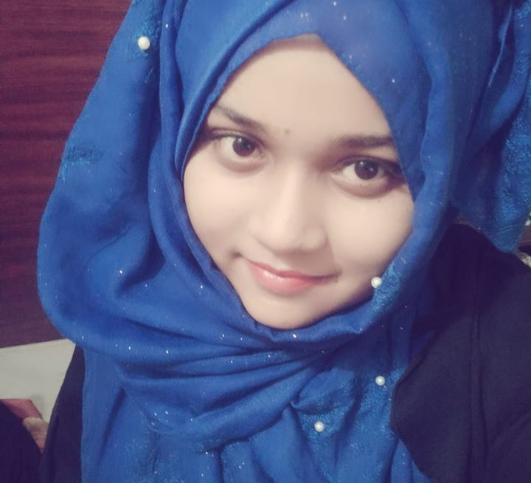
Nusrat Binte Masud
10/A sobhanbag Tallabagh
Dhaka – 1205
01782048393
Nusrat15-9045@diu.edu.bd
SKILLS
-Programming language – C,C++
-Problem solving
-MS Word,Excel,Powerpoint
-Mathematic
Educaion
-Daffodil International university,Dhaka- B.S.C in computer science and Engineering.
Sep 1, 2017-Sep 1, 2021
-Bogra Cantonment Public School & College – SSC
January 1,2002-January 30,2014 (My SSC GPA- 5.00 out of 5.00)
-Govt.Azizul Haque college,Bogra- HSC
July 1,2014-April 1,2016 (My HSC GPA- 4.08 out of 5.00)
Hobby
I love dancing and exercise.And my passion is problem solving.

